Slide 1
Hydro Power

Slide 2
Hydropower
Hydroelectric power comes from flowing water—winter and spring runoff from mountain streams and clear lakes.
Water, when it is falling by the force of gravity, can be used to turn turbines and generators that produce electricity.
Notes:
Hydroelectric power comes from flowing water—winter and spring runoff from mountain streams and clear lakes. Water, when it is falling by the force of gravity, can be used to turn turbines and generators that produce electricity.

Slide 3
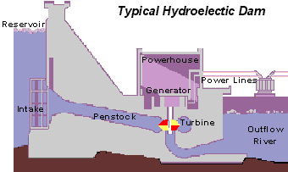
How Hydropower Works! (ctd…)
Water from the reservoir flows due to gravity to drive the turbine.
Turbine is connected to a generator.
Power generated is transmitted over power lines.
Notes:
Hydropower also known as water power, is the use of falling or fast-running water to produce electricity or to power machines.
This is achieved by converting the gravitational potential or kinetic energy of a water source to produce power.^{[2]}
Hydropower is a method of sustainable energy production

Slide 4
Hydropower Advantages
Ability to quickly and readily vary the amount of power generated, depending on the load presented at that moment.
It utilizes a renewable energy source as “fuel” (water)
Generation process is environmentally clean
High reliability

Slide 5
Hydropower Disadvantages
It requires large initial investments
Long transmission lines
Social and environmental impacts for large-scale schemes (will be discussed in detail)

Slide 6
TECHNOLOGY

Slide 7
Technology
Hydropower
Technology
Impoundment
Diversion
Pumped
Storage
Notes:
An impoundment facility, typically a large hydropower system, uses a dam to store river water in a reservoir. Water released from the reservoir flows through a turbine, spinning it, which in turn activates a generator to produce electricity. The water may be released to meet changing electricity needs or other needs, such as flood control, recreation, fish passage, and other environmental and water quality needs.
A diversion, sometimes called a “run-of-river” facility, channels a portion of a river through a canal and/or a penstock to utilize the natural decline of the river bed elevation to produce energy. A penstock is a closed conduit that channels the flow of water to turbines with water flow regulated by gates, valves, and turbines. A diversion may not require the use of a dam.
Another type of hydropower, called pumped storage hydropower, or PSH, works like a giant battery. A PSH facility is able to store the electricity generated by other power sources, like solar, wind, and nuclear, for later use. These facilities store energy by pumping water from a reservoir at a lower elevation to a reservoir at a higher elevation.
When the demand for electricity is low, a PSH facility stores energy by pumping water from the lower reservoir to an upper reservoir. During periods of high electrical demand, the water is released back to the lower reservoir and turns a turbine, generating electricity.

Slide 8
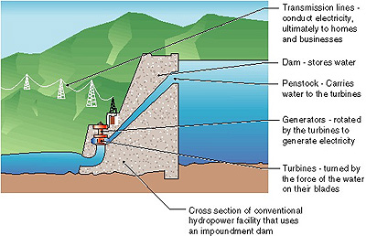
Impoundment facility
Notes:
An impoundment facility, typically a large hydropower system, uses a dam to store river water in a reservoir.
Water released from the reservoir flows through a turbine, spinning it, which in turn activates a generator to produce electricity

Slide 9
Dam Types
Arch
Gravity
Buttress
Embankment or Earth
  Earthfill dams
  Rockfill dams

Slide 10
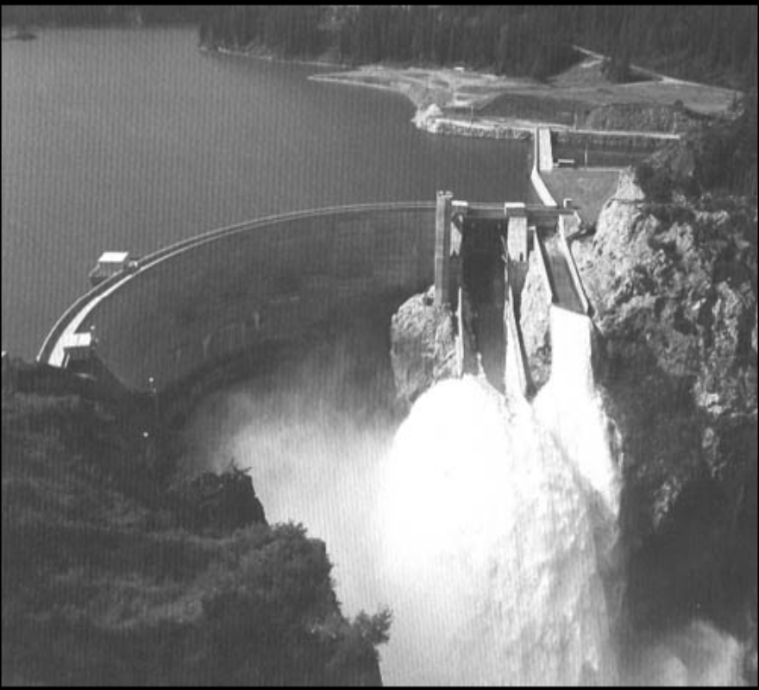
Arch Dams
Arch shape gives strength
Less material (cheaper)
Narrow sites
Need strong abutments
Notes:
Arch dams are made from concrete. They are curved in the shape of an arch, with the top of the arch pointing back into the water. An arch is a strong shape for resisting the pushing force of the water behind the dam. Arch dams are usually constructed in narrow, steep sided valleys. They need good rock for their foundations, and for the sides of the valleys, to resist the forces on the dam.
There are only a few arch dams in the UK, including Monar Dam in Scotland.

Slide 11
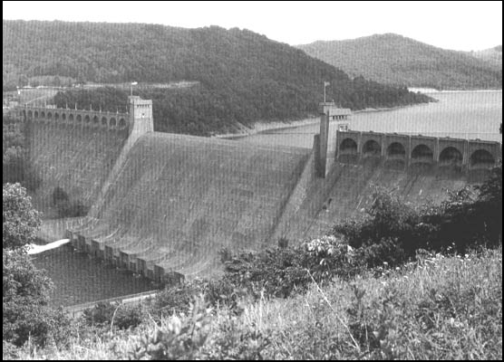
Concrete Gravity Dams
Weight holds dam in place
Lots of concrete (expensive)
Notes:
A gravity dam is made from concrete or masonry, or sometimes both. It is called a gravity dam because gravity holds it down to the ground stopping the water in the reservoir pushing it over.

Slide 12
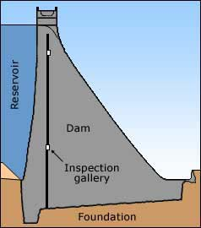
Concrete Gravity Dams
Cross-section through gravity dam
Notes:
A cross-section (or slice) through a gravity dam will usually look roughly triangular.
Gravity dams are suited to sites with either wide or narrow valleys, but they do need to be built on sound rock.
There are more than 250 gravity dams in Britain. Masonry was used in many early dams, as far back as the 17th Century. However, concrete became more common from about 1900.

Slide 13
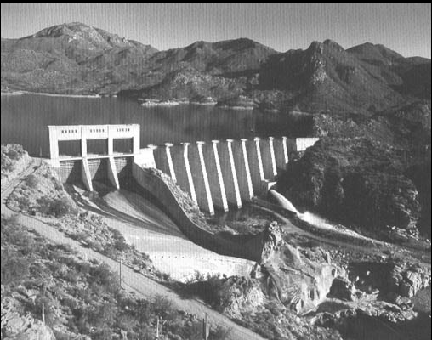
Buttress Dams
Face is held up by a series of supports
Flat or curved face
Notes:
Buttress dams are made from concrete or masonry.
They have a watertight upstream side supported by triangular shaped walls, called buttresses.
The buttresses are spaced at intervals on the downstream side.
They resist the force of the reservoir water trying to push the dam over.
The buttress dam was developed from the idea of the gravity dam, except that it uses a lot less material due to the clear spaces between the buttresses. Like gravity dams, they are suited to both narrow and wide valleys, and they must be constructed on sound rock.
Since 1945, 14 buttress dams have been constructed in the UK, mainly for hydroelectric schemes in Scotland.

Slide 14
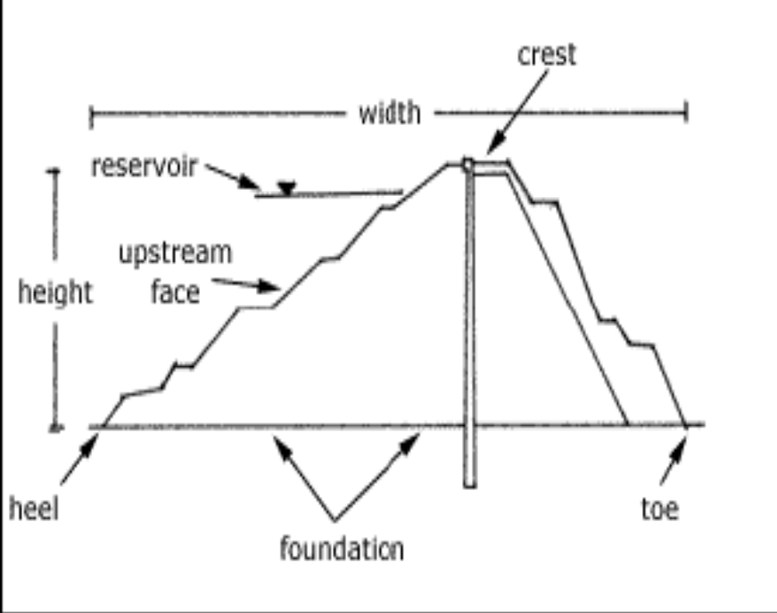
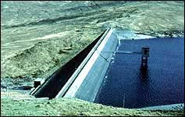
Embankment Dams
Earth or rock
Weight resists flow of water
Notes:
Embankment dams are made mainly from natural materials. The two main types are earthfill dams and rockfill dams. Earthfill dams are made up mostly from compacted earth, while rockfill dams are made up mainly from dumped and compacted rockfill. The materials are usually excavated or quarried from nearby sites, preferably within the reservoir basin.

Slide 15
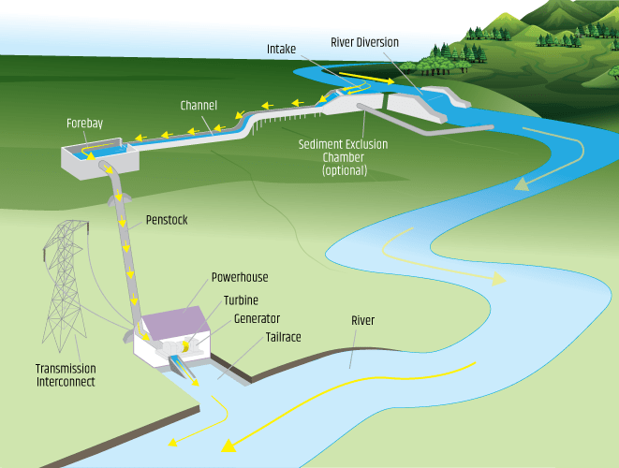
Diversion Facility
Notes:
A diversion, sometimes called a “run-of-river” facility, channels a portion of a river through a canal and/or a penstock to utilize the natural decline of the river bed elevation to produce energy.
A penstock is a closed conduit that channels the flow of water to turbines with water flow regulated by gates, valves, and turbines. A diversion may not require the use of a dam.

Slide 16
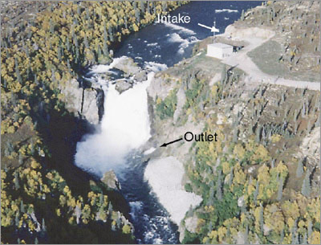
Diversion Facility
Doesn’t require dam
Facility channels portion of river through canal or penstock

Slide 17
Pumped Storage
Another type of hydropower, called pumped storage hydropower, or PSH.
It works like a giant battery.
A PSH facility is able to store the electricity generated by other power sources, like solar, wind, and nuclear, for later use.
These facilities store energy by pumping water from a reservoir at a lower elevation to a reservoir at a higher elevation.
When the demand for electricity is low, a PSH facility stores energy by pumping water from the lower reservoir to an upper reservoir.
During periods of high electrical demand, the water is released back to the lower reservoir and turns a turbine, generating electricity.
Notes:
Another type of hydropower, called pumped storage hydropower, or PSH, works like a giant battery. A PSH facility is able to store the electricity generated by other power sources, like solar, wind, and nuclear, for later use. These facilities store energy by pumping water from a reservoir at a lower elevation to a reservoir at a higher elevation.
When the demand for electricity is low, a PSH facility stores energy by pumping water from the lower reservoir to an upper reservoir. During periods of high electrical demand, the water is released back to the lower reservoir and turns a turbine, generating electricity.

Slide 18
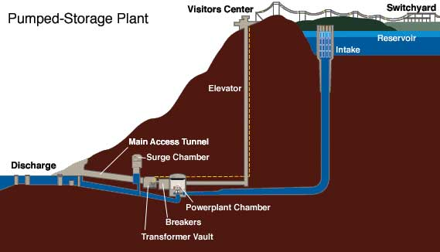
Pumped Storage
During Storage, water pumped from lower reservoir to higher one.
Water released back to lower reservoir to generate electricity.

Slide 19
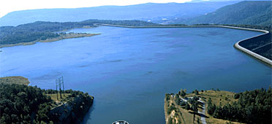
Pumped Storage
Operation : Two pools of Water
Upper pool – impoundment
Lower pool – natural lake, river or storage reservoir
Advantages :
  Production of peak power
  Can be built anywhere with reliable supply of water
The Raccoon Mountain project

Slide 20
Sizes of Hydropower Plants
Definitions may vary.
Large plants : capacity >30 MW
Small Plants : capacity b/w 100 kW to 30 MW
Micro Plants : capacity up to 100 kW
Notes:
Hydropower facilities range in size from large power plants, which supply many consumers with electricity, to small and even ‘micro’ plants, which are operated by individuals for their own energy needs or to sell power to utilities.
Large Hydropower
Although definitions vary, DOE defines large hydropower plants as facilities that have a capacity of more than 30 megawatts (MW).
Small Hydropower
Although definitions vary, DOE defines small hydropower plants as projects that generate between 100 kilowatts and 10 MW.
Micro Hydropower
A micro hydropower plant has a capacity of up to 100 kilowatts. A small or micro hydroelectric power system can produce enough electricity for a single home, farm, ranch, or village.

Slide 21
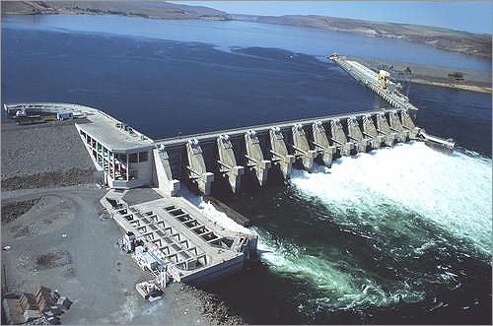
Large Scale Hydropower plant

Slide 22
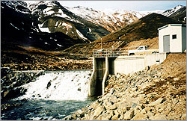
Small Scale Hydropower Plant

Slide 23
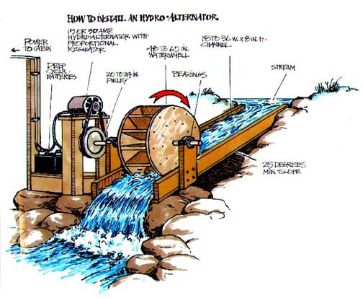
Micro Hydropower Plant

Slide 24
Micro Hydropower Systems
Many creeks and rivers are permanent, i.e., they never dry up, and these are the most suitable for micro-hydro power production
Micro hydro turbine could be a waterwheel
Newer turbines : Pelton wheel (most common)
Others : Turgo, Crossflow and various axial flow turbines

Slide 25
Generating Technologies
Types of Hydro Turbines:
  Impulse turbines
    Pelton Wheel
    Cross Flow Turbines
  Reaction turbines
    Propeller Turbines : Bulb turbine, Straflo, Tube Turbine,
    Kaplan Turbine
    Francis Turbines
    Kinetic Turbines

Slide 26
Impulse Turbines
Uses the velocity of the water to move the runner and discharges to atmospheric pressure.
The water stream hits each bucket on the runner.
No suction downside, water flows out through turbine housing after hitting.
High head, low flow applications.
Types : Pelton wheel, Cross Flow

Slide 27
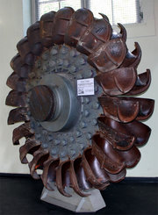
Pelton Wheels
Nozzles direct forceful streams of water against a series of spoon-shaped buckets mounted around the edge of a wheel.
Each bucket reverses the flow of water and this impulse spins the turbine.

Slide 28
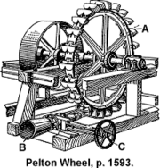
Pelton Wheels (continued…)
Suited for high head, low flow sites.
The largest units can be up to 200 MW.
Can operate with heads as small as 15 meters and as high as 1,800 meters.

Slide 29
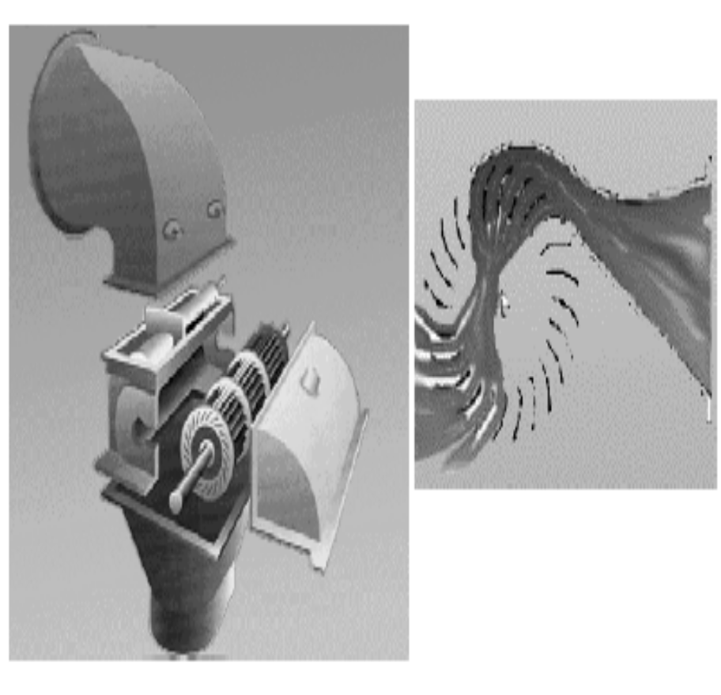
Cross Flow Turbines
drum-shaped
elongated, rectangular-section nozzle directed against curved vanes on a cylindrically shaped runner
“squirrel cage” blower
water flows through the blades twice

Slide 30
Cross Flow Turbines (continued…)
First pass : water flows from the outside of the blades to the inside
Second pass : from the inside back out
Larger water flows and lower heads than the Pelton.

Slide 31
Reaction Turbines
Combined action of pressure and moving water.
Runner placed directly in the water stream flowing over the blades rather than striking each individually.
lower head and higher flows than compared with the impulse turbines.

Slide 32

Propeller Hydropower Turbine
Runner with three to six blades.
Water contacts all of the blades constantly.
Through the pipe, the pressure is constant
Pitch of the blades - fixed or adjustable
Scroll case, wicket gates, and a draft tube
Types: Bulb turbine, Straflo, Tube turbine, Kaplan

Slide 33

Bulb Turbine
The turbine and generator are a sealed unit placed directly in the water stream.

Slide 34
Others…
Straflo : The generator is attached directly to the perimeter of the turbine.
Tube Turbine : The penstock bends just before or after the runner, allowing a straight line connection to the generator
Kaplan : Both the blades and the wicket gates are adjustable, allowing for a wider range of operation

Slide 35
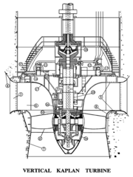
Kaplan Turbine
The inlet is a scroll-shaped tube that wraps around the turbine's wicket gate.
Water is directed tangentially, through the wicket gate, and spirals on to a propeller shaped runner, causing it to spin.
The outlet is a specially shaped draft tube that helps decelerate the water and recover kinetic energy.

Slide 36
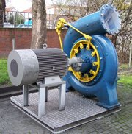
Francis Turbines
The inlet is spiral shaped.
Guide vanes direct the water tangentially to the runner.
This radial flow acts on the runner vanes, causing the runner to spin.
The guide vanes (or wicket gate) may be adjustable to allow efficient turbine operation for a range of water flow conditions.

Slide 37
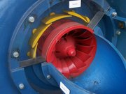
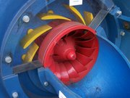
Francis Turbines (continued…)
Best suited for sites with high flows and low to medium head.
Efficiency of 90%.
expensive to design, manufacture and install, but operate for decades.

Slide 38
Kinetic Energy Turbines
Also called free-flow turbines.
Kinetic energy of flowing water used rather than potential from the head.
Operate in rivers, man-made channels, tidal waters, or ocean currents.
Do not require the diversion of water.
Kinetic systems do not require large civil works.
Can use existing structures such as bridges, tailraces and channels.

Slide 39
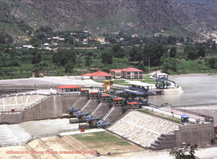
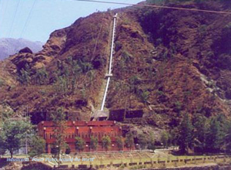
Hydroelectric Power Plants in India
Baspa II Binwa

Slide 40
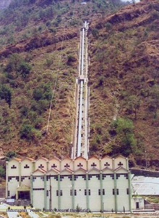
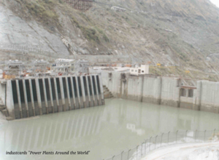
Continued …
Gaj
Nathpa Jakri

Slide 41
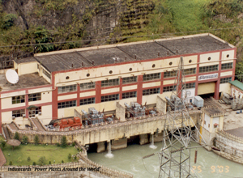
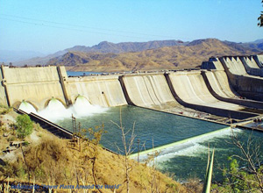
Continued…
Rangit
Sardar Sarovar

Slide 42
ENVIRONMENTAL IMPACT

Slide 43
Benefits…
Environmental Benefits of Hydro
• No operational greenhouse gas emissions
• Savings (kg of CO2 per MWh of electricity):
– Coal 1000 kg
– Oil 800 kg
– Gas 400 kg
• No SO2 or NOX
Non-environmental benefits
– flood control, irrigation, transportation, fisheries and
– tourism.

Slide 44
Disadvantages
The loss of land under the reservoir.
Interference with the transport of sediment by the dam.
Problems associated with the reservoir.
  Climatic and seismic effects.
  Impact on aquatic ecosystems, flora and fauna.

Slide 45
Effects
Capture of sediment decreases the fertility downstream as a long term effect.
It also leads to deprivation of sand to beaches in coastal areas.
If the water is diverted out of the basin, there might be salt water intrusion into the inland from the ocean, as the previous balance between this salt water and upstream fresh water in altered.
It may lead to changes in the ecology of the estuary area and lead to decrease in agricultural productivity.

Slide 46
Climatic and Seismic effects
It is believed that large reservoirs induce have the potential to induce earthquakes.
In tropics, existence of man-made lakes decreases the convective activity and reduces cloud cover. In temperate regions, fog forms over the lake and along the shores when the temperature falls to zero and thus increases humidity in the nearby area.

Slide 47
Eutrophication
In tropical regions due to decomposition of the vegetation, there is increased demand for biological oxygen in the reservoir.
The relatively constant temperatures inhibit the thermally induced mixing that occurs in temperate latitudes.
In this anaerobic layer, there is formation of methane which is a potential green house gas.
This water, when released kills the fishes downstream and creates an unattractive odor. The only advantage is that all these activities are not permanent.

Slide 48
Other problems
Many fishes require flowing water for reproduction and cannot adapt to stagnant resulting in the reduction in its population.
Heating of the reservoirs may lead to decrease in the dissolved oxygen levels.
The point of confluence of fresh water with salt water is a breeding ground for several aquatic life forms. The reduction in run-off to the sea results in reduction in their life forms.
Other water-borne diseases like malaria, river-blindness become prevalent.

Slide 49
Methods to alleviate the negative impact
Creation of ecological reserves.
Limiting dam construction to allow substantial free flowing water.
Building sluice gates and passes that help prevent fishes getting trapped.

Slide 50
Case Study- Volta Lake, Ghana
Volta lake was formed as a result of the construction of the Akosombo Dam.
It was aimed at providing much needed power needs for domestic consumption and for the production of Aluminium.
Even though much study was conducted prior to the construction, many favorable and adverse environmental changes took place.

Slide 51
Favorable impact
Enhanced fishing upstream.
Opportunities for irrigated farming downstream.
With the flooding of the forest habitat of the Tsetse fly, the vector of this disease, the problem of Sleeping Sickness has been substantially reduced.

Slide 52
Negative Impact
Diminished fishing downstream.
Growth of long lasting weeds like Pistia, Vossia spp. Ceratophyllum.
Ceratophyllum’s submerged beds house large populations of Bulinus snails the vector of Schistosomiasis.
Growth of dangerous water weeds like water hyacinth.
Prevalence of river blindness (Snchocerchiasis), bilharzia (Schistosomiasis), malaria and Sleeping Sickness (Trypanosomiasis

Slide 53
Technological advancements
Technology to mitigate the negative environmental impact.
  Construction of fish ways for the passage of fish through, over, or around the project works of a hydro power project, such as fish ladders, fish locks, fish lifts and elevators, and similar physical contrivances
  Building of screens, barriers, and similar devices that operate to guide fish to a fish way

Slide 54
Continued…
Evaluating a new generation of large turbines
  Capable of balancing environmental, technical, operational, and cost considerations
Developing and demonstrating new tools
  to generate more electricity with less water and greater environmental benefits
  tools to improve how available water is used within hydropower units, plants, and river systems
Studying the benefits, costs, and overall effectiveness of environmental mitigation practices

Slide 55
Production Costs
Compared with fossil-fuelled plant
– No fuel costs
– Low O&M cost
– Long lifetime

Slide 56
Environmental and Other Concerns
There have been little to no attempts made toward removing accumulations of toxic materials and other potential pollutants from industrial sites that will be inundated. They number more than 1600 in all.
The dam will disrupt heavy silt flows in the river. It could cause rapid silt build-up in the reservoir, creating an imbalance upstream, and depriving agricultural land and fish downstream of essential nutrients. However, sufficient studies have not been conducted.

Slide 57
The Indian Scenario
The potential is about 84000 MW at 60% load factor spread across six major basins in the country.
Pumped storage sites have been found recently which leads to a further addition of a maximum of 94000 MW.
Annual yield is assessed to be about 420 billion units per year though with seasonal energy the value crosses600 billion mark.
The possible installed capacity is around 150000 MW (Based on the report submitted by CEA to the Ministry of Power)

Slide 58
Continued …
The proportion of hydro power increased from 35% from the first five year plan to 46% in the third five year plan but has since then decreased continuously to 25% in 2001.
The theoretical potential of small hydro power is 10071 MW.
Currently about 17% of the potential is being harnessed
About 6.3% is still under construction.

Slide 59
Major Hydropower generating units
NAME | STATA | CAPACITY (MW)
BHAKRA | PUNJAB | 1100
NAGARJUNA | ANDHRA PRADESH | 960
KOYNA | MAHARASHTRA | 920
DEHAR | HIMACHAL PRADESH | 990
SHARAVATHY | KARNATAKA | 891
KALINADI | KARNATAKA | 810
SRISAILAM | ANDHRA PRADESH | 770

Slide 60
Disadvantages and limitations
Dam failure
  Catastrophic type of structural failure characterized by the sudden, rapid, and uncontrolled release of impounded water or the likelihood of such an uncontrolled release.
  Between the years 2000 and 2009 more than 200 notable dam failures happened worldwide.
  This can have catastrophic effects, including loss of life, property and pollution of land.
Dams and reservoirs can have major negative impacts on river ecosystems
  Prevents some animals traveling upstream,
  Prevents cooling and de-oxygenating of water released downstream, and
  Loss of nutrients due to settling of particulates

Slide 61
Disadvantages and limitations
Large and deep dam and reservoir plants cover large areas of land
  This causes greenhouse gas emissions from underwater rotting vegetation.
  When organic matters accumulate at the bottom of the reservoir, the deoxygenation of water triggers anaerobic digestion.
People who live near a hydro plant site are displaced during construction or when reservoir banks become unstable.
Another potential disadvantage is cultural or religious sites may block construction

Slide 62
Links
https://www.energy.gov/eere/water/types-hydropower-plants
PowerPoint Presentation - No Slide Title (fsu.edu)
PowerPoint Presentation - No Slide Title (fsu.edu)

